Slide 1

Topic: Statistics Investigation EQ: What is the Problem that I need to solve and what mathematics can I use to solve the Problem?
Year 7 Mathematics
Mrs Parlevliet

Slide 2
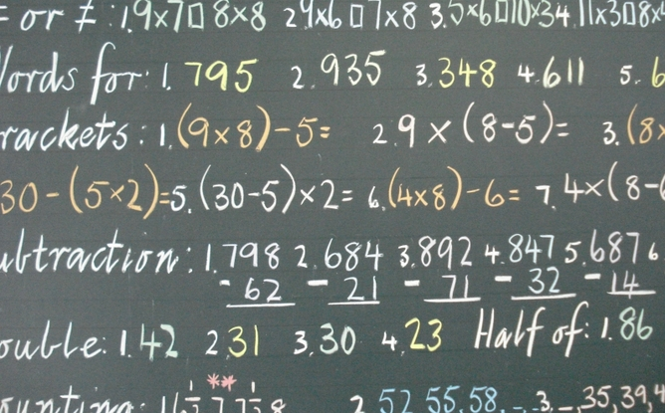
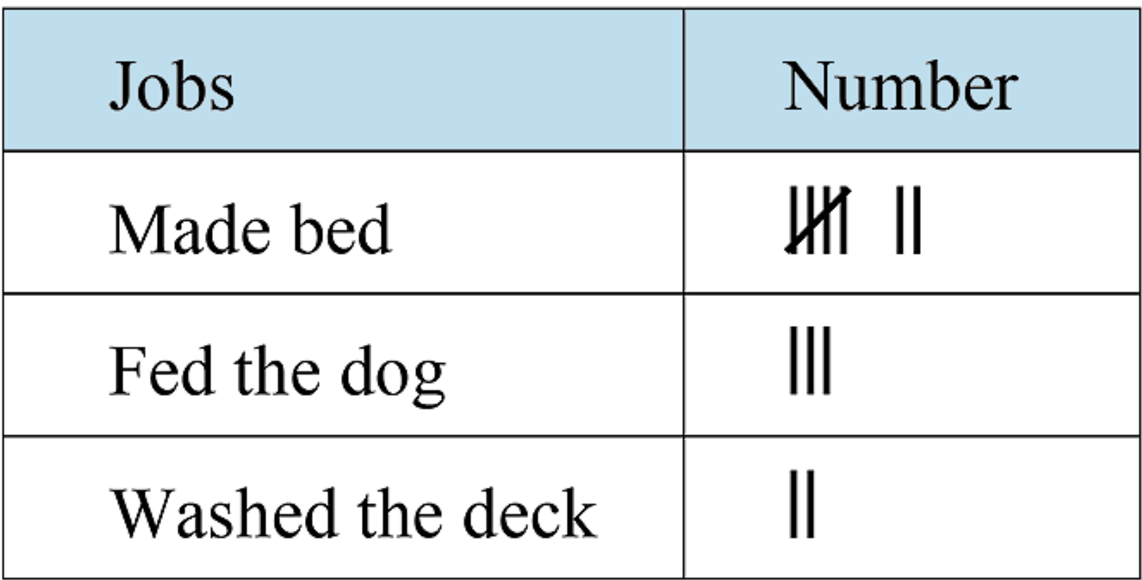
Five Questions (LHS)
Topic: Statistics EQ: What is the Problem that I need to solve and what Mathematics can I use to solve the Problem?
Date: XX/XX/2021
Determine the mean, mode, median, and range of this set of data to two decimal places when necessary: 4, 6, 6, 3, 2, 3, 6
Giselle does odd jobs around the house to earn pocket money. She gets $2 per job. The table shows all the jobs she did in one week. If Giselle does the same jobs for two weeks, how much will she earn altogether?
This Photo by Unknown Author is licensed uder CC BY-ND
Notes:
Question 1 Mean = 30/7 = 4.285714… = 4.29
Mode = 6
2, 3, 3, 4, 6, 6, 6
Median = 4
Range = 6-2 =4
Question 2 12 jobs completed in one week
12*3=$36 in one week
In two weeks, $72

Slide 3
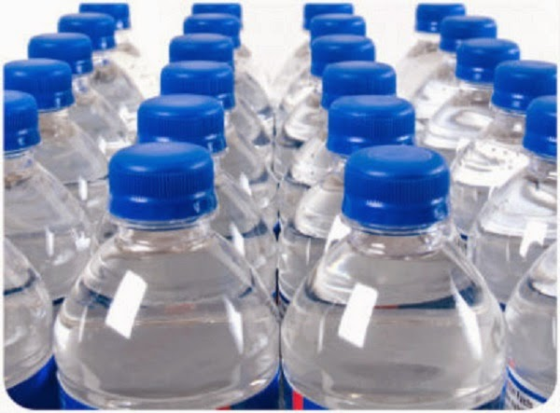
Agree or DisaGREE?
Our school canteen should stop selling bottled water.
Notes:
Four Corners – Explain to students that a statement will be shown and they need to decide whether they agree or disagree with the statement. There is no right or wrong answer. Point out which corners of the room correspond to ‘strongly agree’, agree, disagree and ‘strongly disagree’.
1. Share this statement with students: Our school canteen (or community) should stop selling bottled water.
2. Tell students that they will be standing in one of the corners of the room according to how they feel about the statement. Ask students to choose a place to stand. Give the students a few minutes to talk to the people near them and discuss why they have placed themselves where they are. Ask several students to explain to the class why they are standing where they are.
3. Ask students to return to their seats and to record their position, and reason for choosing this position, in their books.

Slide 4
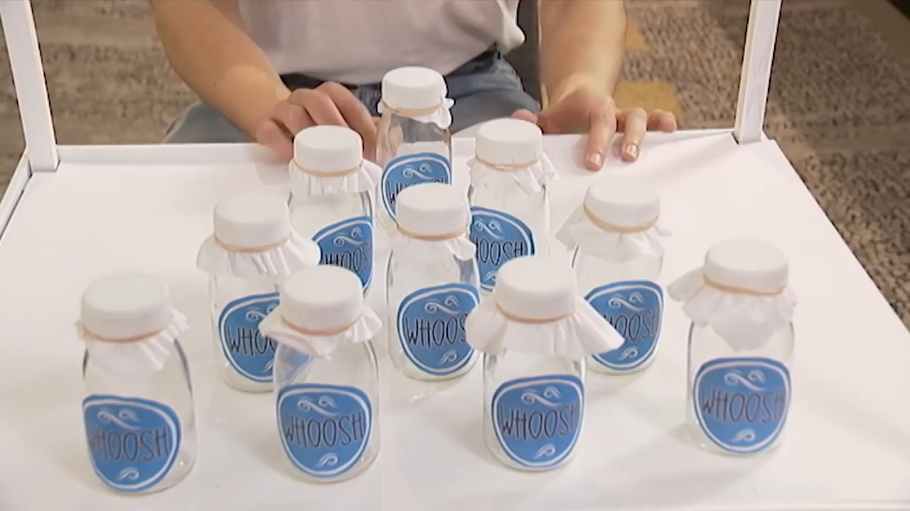
Bottled Water Vs Tap Water
https://www.youtube.com/watch?v=XbxQy5En5Rw
Notes:
Placemat Activity
Arrange students into Groups of 4. Ask them to number themselves from 1-4.
Assign the tasks to the numbered students:
Where does drinking water come from in Australia?
What is the quality of drinking water in Australia?
What are the benefits of bottled water?
Interesting or new information presented.
After the video have the students fill in the placemat section that they are responsible for.
Run a discussion based on the video of bottled water vs tap water about why people buy bottled water. Guide the discussion towards the distance water would need to travel to get to them.
Which source of water would travel further? Students return to their original seats.

Slide 5
24
7
30
Topic: Statistics
Date: XX/XX/2021
EQ: What is the Problem that I need to solve and what mathematics can I use to solve the Problem?
What part of the Mathematical Thinking Process do I use to identify the problem and begin solving a problem?
The two steps of the Mathematical Thinking Process that can help me identify the problem to solve and how to solve the problem are:
Interpret the task and gather information
Identify the mathematics which could help to complete the task
Notes:
Student Instructions Look at the previous lesson where we covered the Mathematical Thinking Process. What steps can answer our question in the margin? 24/7/30 Skill after writing the notes down. Go back to yesterday’s notes for Steps 1 and 2. What new information have we just learned that we can add to the RHS to better explain Steps 1 and 2? Add that now. Hand out the How far does water travel? task to students.

Slide 6

How Far does Water Travel?
Spend 1 minute scanning the task that you have just been given.
Take notice of the headings
Is this a collaborative task or an individual task?
What needs to be produced?
After scanning, we will have a short discussion of what we need to do before doing a critical reading of the task. Be prepared to share your ideas.
This Photo by Unknown Author is licensed under CC BY-SA

Slide 7
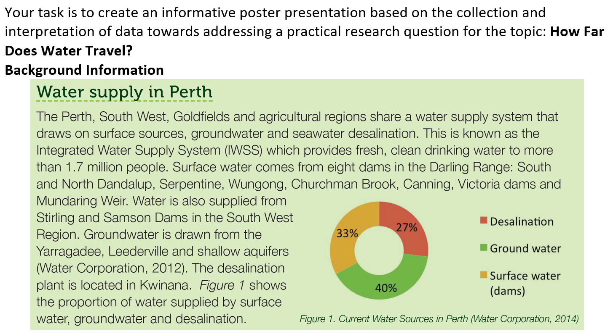
How Far does Water Travel?
Highlighting keywords
Using a highlighter we will be highlighting keywords. If you do not have a highlighter, you can use a pen to underline keywords.
We can only highlight 20 keywords in this section.
When we are using the strategy of highlighting, we need to focus on the words that support the main idea of the section we are reading.
What is the main idea of this section?
Notes:
RHS Highlighting
When we are using the strategy of highlighting, we need to focus on the words that support the main idea of the section we are reading.

Slide 8
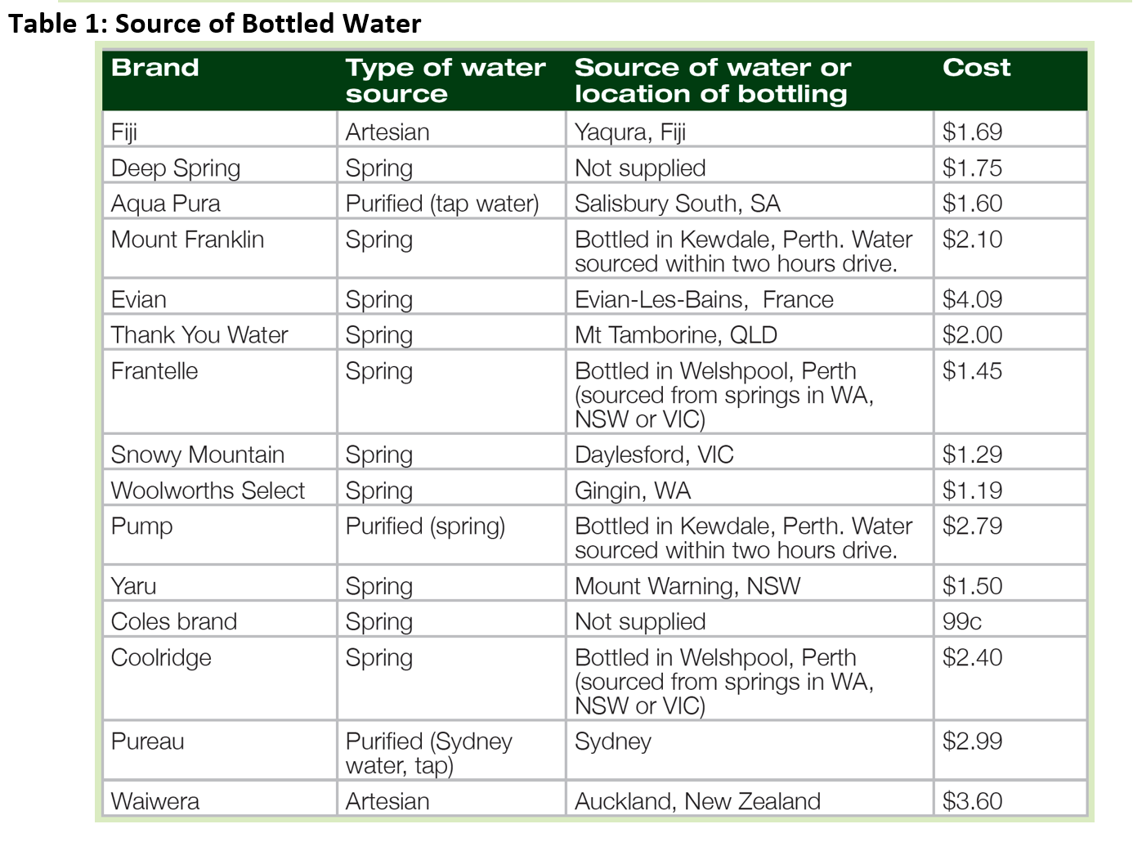
How Far does Water Travel?
Reading Tables of Data
Can we summarise what the information of the table shows into 1-2 sentences?
When we summarise what we are doing is getting to the point clearly.
Notes:
RHS
Summarising Strategy
When we summarise what we are doing is getting to the point clearly

Slide 9
How Far does Water Travel?
How can we use this information to help solve the problem?
Notes:
RHS
Is there enough information to start research?
What are we trying to find out?

Slide 10
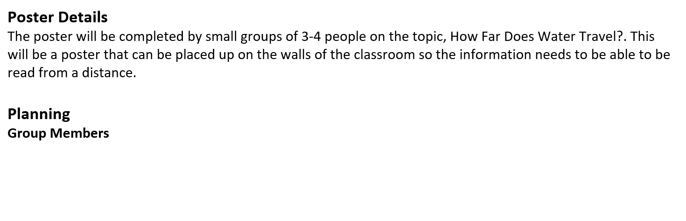
How Far does Water Travel?
Working Collaboratively
Notes:
What makes a good group member?
Are you willing to be a good group member?
PBS Lesson – Working Collaboratively Y-Chart

Slide 11
In Your Groups
Complete Step 1 and Step 2 before the end of the lesson.
Everyone needs to have information written in Step 1 and Step 2.
We are continuing with Step 3 and 4 next lesson.

